Slide 1
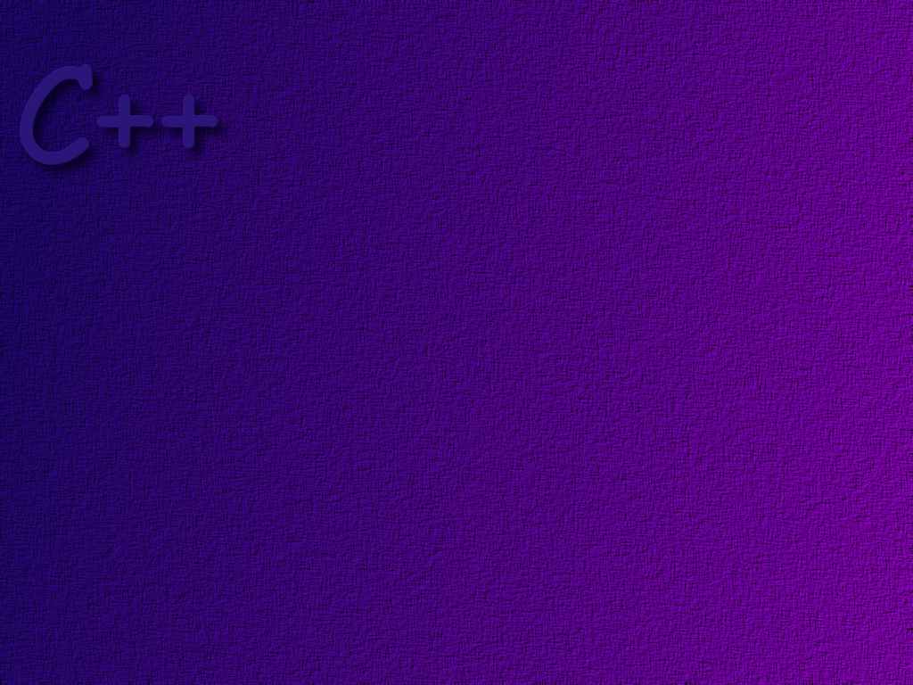
Recursion

Slide 2
Objectives
At the conclusion of this lesson, students should be able to
Explain what recursion is
Design and write functions that use recursion
“Think” recursively

Slide 3
A function that calls itself is said to be recursive.

Slide 4
Example
Write a function that takes an integer value,
and writes the individual digits of the integer
down the screen in a vertical line.
for example,
writeVertical (123);
would produce
1
2
3

Slide 5
The function can be broken down into two tasks.
Simple case: if n < 10, then just write the number
n to the screen. After all, the number is just one
digit long and there is nothing else to do.
Recursive case: if n >= 10, there are two things
to do:
1. Output all digits except the last one
2. Output the last one

Slide 6
So, given the integer 1234
we note that 1234 is bigger than 10, so the first step
is to call writeVertical(123)
and then output 4.
1
2
3
then, given the integer 123
we note that 123 is bigger than 10, so the first step
is to call writeVertical(12)
and then output 3.
4
then, given the integer 12
we note that 12 is bigger than 10, so the first step
is to call writeVertical(1)
and then output 2.
finally, given the integer 1
we note that 1 is less than 10, so we output it.

Slide 7
We could describe the writeVertical algorithm
using the following pseudocode:
if (n < 10)
output n;
else // since n is two or more digits long
{
writeVertical (n with the last digit removed);
ouput the last digit;
}

Slide 8
We can remove the last digit of a
positive integer n, by dividing the
number by 10.
For example
if n = 34786,
then
n / 10 = 3478
because of
integer division!

Slide 9
We can calculate the last digit of a
positive integer n, by dividing the
number by 10 and taking the remainder.
For example
if n = 34786,
then
n % 10 = 6

Slide 10
So, the writeVertical function looks like …
void writeVertical( int n)
{
if (n < 10)
cout << n << endl;
else
{
writeVertical (n/10);
cout << (n % 10) << endl;
}
}

Slide 11
General Outline of a Recursive Function
It must have one or more cases where the
algorithm accomplishes its task by calling
itself with a subset of the original task to
be done.
It must have at least one case where the
algorithm accomplishes its task without
having to call itself. This is called the
stopping or base case.
Without this base case, the algorithm will
run “forever”. This is called infinite recursion.

Slide 12
Stack Overflow
Recall that function calls make use of the runtime
stack to pass parameters and the address to return to
when the function has completed its work.
When a recursive function has no stopping case,
the function calls itself over and over again until
the stack fills up. This results in a stack overflow
error.

Slide 13
Recursion vs. Iteration
In many cases, a task can be done by using iteration
(loops) instead of recursion.
In general, recursive functions are simpler than
iterative ones.
However, recursive functions usually run slower and
take more storage than their iterative counterparts.

Slide 14
Iterative Version of writeVertical
void writeVertical (int n)
{
int nsTens = 1;
int leftEndPiece = n;
while (leftEndPiece > 9)
{
leftEndPiece = leftEndPiece / 10;
nsTens = nsTens * 10;
}
for (int ptns = nsTens; ptns > 0; ptns / 10)
{
cout << (n / ptns) << endl;
n = n % ptns;
}
}
we calculate a power of ten that
has the same number of digits
as the number n.

Slide 15
Recursive Functions that Return a Value
One or more cases where the value returned is calculated
by the function calling itself with a “smaller” set of data.
A base case where the value to be returned can be
calculated without the function having to call itself.

Slide 16
Example
write the function
int power (int n, int p);
which returns the number n raised to the
power p, as an integer.

Slide 17
int power (int n, int p)
{
if (p > 0)
return ( power (n, p-1) * n);
else
return (1);
}

Slide 18
int power (int n, int p)
{
if (p > 0)
return ( power (n, p-1) * n);
else
return (1);
}
int n = power (3, 2);
p
if (2 > 0)
return ( * 3);
else
return (1);
power (3, 1)
9
if (1 > 0)
return ( * 3);
else
return (1);
power (3, 0)
3
if (0 > 0)
return ( power (3, -1) * 3);
else
return (1);
1
stopping case!

Slide 19
Recursive Design Techniques
When thinking about a recursive function, you
do not have to trace out the entire sequence of
function calls and returns in order to validate
that the function works.

Slide 20
All you need to do is to check and make sure that the
following three conditions are satisfied:
There is no infinite recursion.
Each stopping case returns the correct value
for that case.
For the cases that involve recursion, if all recursive calls
return a correct value, then the final value returned by the
function will be correct.

Slide 21
Consider the Power function we just wrote …
int power (int n, int p)
{
if (p > 0)
return ( power (n, p-1) * n);
else
return (1);
}
There is no infinite recursion. The second argument
to power (x, n) is decreased by 1 each time the function
calls itself, so any sequence of calls will eventually
result in the call to power (x, 0), which is the stopping
case.

Slide 22
int power (int n, int p)
{
if (p > 0)
return ( power (n, p-1) * n);
else
return (1);
}
Each stopping case returns a correct value. There is
only one stopping case, when power (x, 0) is called.
It always returns a 1, which is the correct value for
x⁰ (anything to the zero power = 1).

Slide 23
int power (int n, int p)
{
if (p > 0)
return ( power (n, p-1) * n);
else
return (1);
}
For the cases that involve recursion, if all recursive calls
return the correct value for that case, then the final value
returned by the function will be the correct value. The only
case that involves recursion is when p > 1. In that case,
power (x, p) returns power (x, p-1) * x.

Slide 24
Is this correct?
If we assume that power (x, n-1) returns the
correct value, then power (x, n-1) returns
x^{n-1}.
Therefore, power (x, n) must return
x^{n-1} * x,
which is x^{n}.

Slide 25
Criteria for a void Function
There is no infinite recursion.
Each stopping case performs the correct action
for that case.
For the cases that involve recursion, if all recursive calls
perform their actions correctly, then the entire case
performs correctly.

Slide 26
A Recursive Binary Search
Problem: Search an array to see if it contains
a specified value.
Let the array be defined as a [0], a[1], a[2], … a[size-1]
Assume that the array is sorted.

Slide 27
1. Look at the middle item in the array.
2. Is it the value I’m looking for?
Well, if it is, we are done!
If the value is bigger than the one I’m
looking for, then, because the array is
sorted, we know that the value must
be somewhere in this range.
or, if the value is smaller than the
one I’m looking for, it must be in
this range.
In either case, we repeat the process exactly,
on this smaller unit of data.

Slide 28
Sounds like a perfect application of Recursion!

Slide 29
pseudocode
this works the first time,
but what about subsequent
recursions?
search (a[0] through a[final] to find key)
{
found = false; // so far
mid = approximate midpoint between 0 and final;
if (key == a[mid])
{
found = true;
location = mid;
}
else if (key < a[mid])
search (a[0] through a[mid-1] to find key);
else if (key > a[mid])
search (a[mid+1] through a[final] to find key);

Slide 30
pseudocode
start with first = 0 and
last = final.
search (a[first] through a[last] to find key)
{
found = false; // so far
mid = approximate midpoint between 0 and final;
if (key == a[mid])
{
found = true;
location = mid;
}
else if (key < a[mid])
search (a[first] through a[mid-1] to find key);
else if (key > a[mid])
search (a[mid+1] through a[last] to find key);
this block of code guarantees
that there is a stopping case
if the value is found! What if
it is never found?

Slide 31
pseudocode
start with first = 0 and
last = final.
search (a[first] through a[last] to find key)
{
if (first > last)
found = false;
else
{
mid = approximate midpoint between 0 and final;
if (key == a[mid])
{
found = true;
location = mid;
}
else if (key < a[mid])
search (a[first] through a[mid-1] to find key);
else if (key > a[mid])
search (a[mid+1] through a[last] to find key);
}
}
if first passes last then
we have searched the
entire array. Set found
= false and drop out.

Slide 32
Check the Recursion
There is no infinite recursion: If the value is found, that
is a stopping case. On each recursive call,
either the value of first is increased or the value of
last is decreased. If the value is not ever found, the
value of first will eventually be greater than the value
of last. This is also a stopping case.

Slide 33
Each stopping case performs the correct action for
that case: There are two stopping cases.
1. If first > last, there can be no array elements between
a[first] and a[last], so the key does not exist in the
array. The function correctly sets found to false.
2. key == a[mid], the algorithm correctly sets the value
of location to mid and found = true.

Slide 34
For each case that involves recursion, if all recursive
calls produce the correct action, then the entire case
performs correctly: There are two recursive cases:
1. key < a[mid], the key must lie between a[first]
and a[mid-1], so the function should now search
this interval, which it does.
2. key > a[mid], the key must lie between a[mid+1]
and a[last], so the function should now search
this interval, which it does.

Slide 35
Write a recursive function to calculate n!
Prove that it works in all cases by showing:
There a stopping case?
The stopping case returns a correct value?
Each recursive case returns a correct value?

Slide 36
We know that n! equals n * (n-1)!
int factorial( int n )
{
if (n > 1 )
return n * factorial(n-1);
else
return 1;
}
Each recursive case
produces n * (n-1)!
Here is the stopping case
If n equals 1.
We know that 1! = 1

Slide 37
Thinking Recursively
Solving problems by using recursion requires
that you think about the problem in a much
different way than you do when solving the
problem using iteration.

Slide 38
A palindrome is a sequence of characters that reads
the same both frontwards and backwards.
rotor
Madam I’m Adam

Slide 39
Let’s come up with a function
bool isPalindrome(string s)
that tests a string to see if it is a palindrome.

Slide 40
1
The basic approach to solving a problem
recursively is to see if we can reduce the
problem to one that takes “simpler” inputs.
cut the input in half
remove some of the input

Slide 41
For our function
bool isPalindrome(string s)
the input is a string, s. How can we simplify
the string?
remove the first character
remove the last character
remove both the first and last character
cut the string into two halves
. . .
Each of these simpler inputs should be
a potential for our palindrome test.

Slide 42
For example, given the word rotor. . .
removing the first character gives us otor
not a palindrome
removing the last character gives us roto
not a palindrome
cut the string in half gives us ro and tor
not palindromes
removing the first and last characters gives us oto
this looks promising. If I can show that
oto is a palindrome than I know that
rotor is one also, because I get the original
string, rotor, by adding the same character,
r, at the front and the back of oto!

Slide 43
2
Now, find a solution to the simplest
possible inputs.
A recursive function keeps simplifying its inputs.
You must be able to identify how your solution
deals with the simplest of all possible inputs.

Slide 44
For our palindrome example, the simplest
of all possible inputs could be
* a two character string
* a single character string
* an empty string
You can still simplify this string
A single character is equal to itself
may be harder to visualize, but this is a palindrome

Slide 45
3
Implement the solution by combining the
simplest cases with a step to reduce each
parameter to a simpler form

Slide 46
bool isPalindrome(string s)
{
// simple case
if (s.length( ) <= 1)
return true;
// see of the first and last character are the same
char first = s[0];
char last = s[s.length( ) -1];
// if they are, then see if the remaining
// string is a palindrome
if (first == last)
{
string shorter = s.substr(1, s.length( ) - 2);
return isPalindrome(shorter);
}
else return false;
}

Slide 47
Recursive Helper Functions
Sometimes it is easier to re-state the original
problem just a bit and then use a recursive
helper function to solve the re-stated problem.

Slide 48
In the solution to our palindrome problem, we
repeatedly created a new smaller string, then
tested that new string to see if it was a palindrome.
Consider the case where we simply test a
substring of the original string, rather
than create a new string each time.

Slide 49
bool substringIsPalindrome(string s, int start, int end)
{
// the simplest cases - substring length 1 or zero
if (start >= end) return true;
if (s[start] == s[end])
return substringIsPalindrome(s, start+1, end-1);
else
return false;
}

Slide 50
Now our isPalindrome function looks like
bool isPalindrome(string s)
{
return substringIsPalindrome(s, 0, s.length( ) - 1);
}

